Slide 1





Group Project

Slide 2








Team Members
Basmala Mohsen
Manar Ayman
Sarah Muslim
Adham ElSharkawy
Mohamed Mostafa
Omar ElWardany

Slide 3



Project Goal and Overview
Our goal was to explore how we can reduce delay time and, in turn, help the company increase profit and improve customer satisfaction through smart data analysis, forecasting, and dashboarding.
We used tools like Python, SQL, Power BI, and Tableau to clean the data, extract key insights, simulate business impact, and support data-driven decision-making.

Slide 4


Project Steps
1.
Brainstorming and Understand the data
2.
Data Cleaning and Preprocessing
3.
Data Modeling
4.
Data Analysis
5.
Forecasting
6.
Dashboard

Slide 5








The Process
Data Cleaning
Data Modeling
Data Analysis
Forecasting
Visualization
Remove duplicates
Deal with nulls
Remove last raw
Data Format
Calculate Lead Time
Calculate Delay Time
Create dim tables
Created a fact table
Defined primary and foreign keys
Established relationships between fact and dim tables
Delayed stations
Analyzed ticket types
Delayed journeys
Detect rush hour
Analyze causes of delay
Explored delay trends
Trend & Seasonality
Forecast Sales
Managers
Operation Team
Customer service

Slide 6
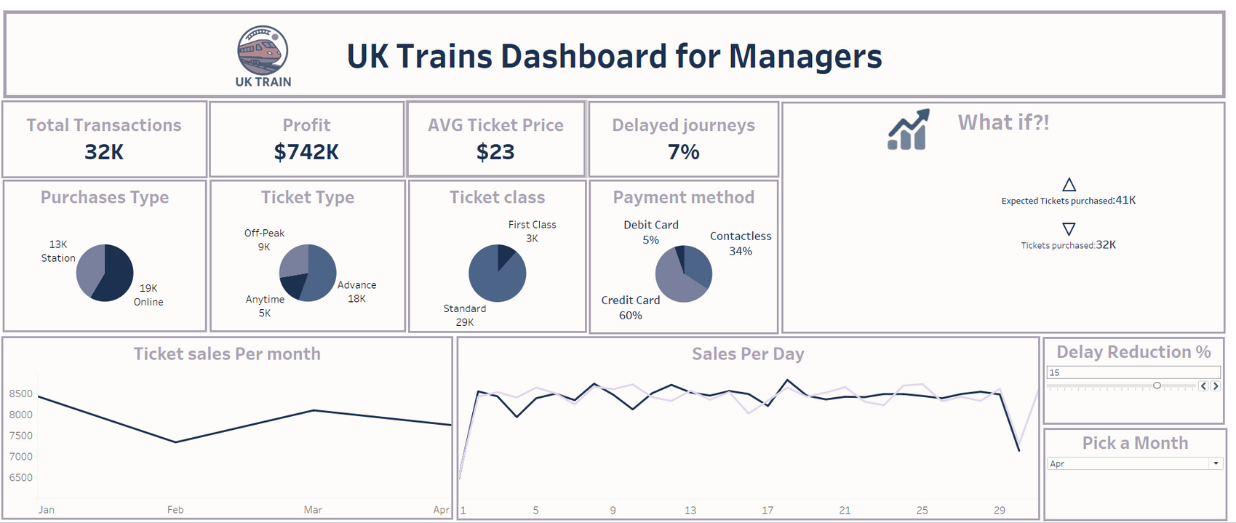


Insights
Most people buy tickets online and in advance.
Standard class is super popular.
Credit cards are the favorite way to pay.
7% of journeys are delayed.
Decrease Sales in Feb.

Slide 7


Solutions and Recommendations
Push more online and early booking offers.
Try First class promotions to increase interest.
Enhance services for credit card transactions.
Run monthly promotions for off-peak and anytime tickets to attract attention.
Focus on reducing delays – it matters.

Slide 8
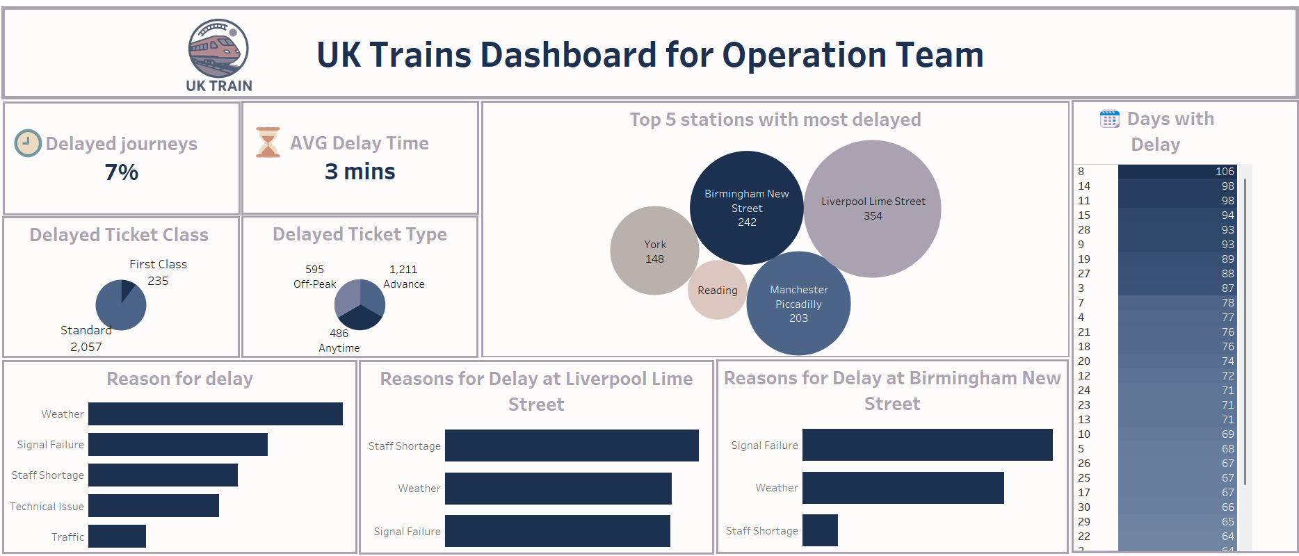
Only 7% of journeys are delayed, and the average delay is just 3 mins.
Standard class gets most of the delays.
Most delays happen with Advance tickets.
Liverpool Lime Street and Birmingham New Street are the top trouble spots.
Main delay reasons: weather, signal failure, and staff shortage.
.
Insights

Slide 9
Solutions and Recommendations
Focus delay-reduction efforts on busy stations like Liverpool and Birmingham.
Boost Staff Availability.
Improve Signal Maintenance.
Weather Contingency Plans.
Focus on High-Delay Days.
Prioritize Advance Ticket Journeys.
Geo-Targeted Strategies

Slide 10
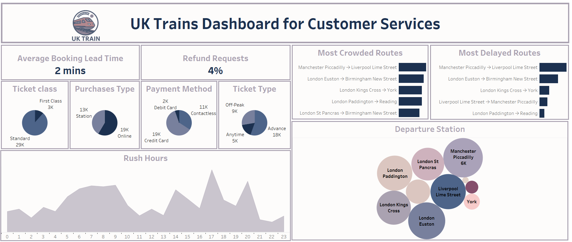
Standard Class is the Most Popular.
Online Booking is the Main Channel.
Credit Card and Contactless are the Top Payment Methods.
Refund Rate at 4%.
Peak hours are in the early morning and early evening.
Some of the busiest routes are also the most delayed.
Stations like London Euston, Liverpool Lime Street, and Manchester Piccadilly have the highest departure volumes.
Insights

Slide 11
Solutions and Recommendations
Improve Service on Busy and Delayed Routes.
Promote Digital Services.
Prepare for Rush Hours.
Understand Refund Reasons.
Focus on High-Pressure Routes.
Encourage Online and Contactless Sales.
Reduce refund requests.

Slide 12


Thank You

